Slide 1
Intro to C

Slide 2
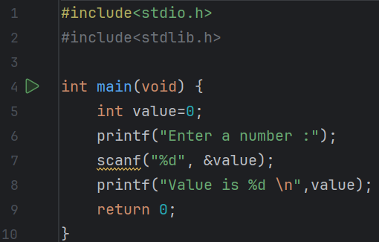
Predict
What do you think this code does?
I think that it would ask the user to input a number and then would output to them what the number they entered was

Slide 3
Run
Download the code from Github and run it!
What does the code do?
It asked me to enter a number and then printed what the number was
Does this match your prediction?
Yes

Slide 4
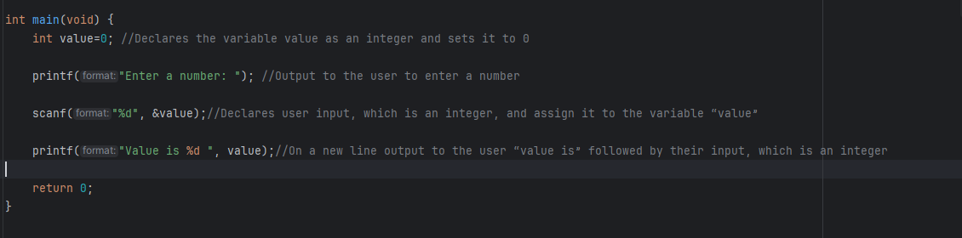
Investigate
Investigation Activities
What is the name of the variable being used? value What data type does it hold?integer(whole number) Annotate lines 5 – 8 to explain what each line of code does. Why is line 2 greyed out?it is a library function which has not been used

Slide 5
Modify
Modification Activities
Change the messages displayed to make them more polite. Modify the program to take the following as inputs instead: Float String Modify the program so that it takes two integers: adds them together and displays the result. Subtracts the second from the first.
Some Data Types | int : %d – a whole number. Uses 2 bytes of storage. float : %f – a real number e.g. has a decimal point. Uses 4/ 8 bytes. char : %c – one individual ASCII character. Uses one byte. string : %s – a list of ASCII characters e.g. a word or series of words

Slide 6
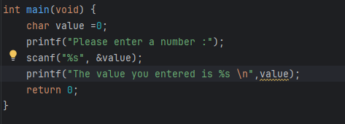
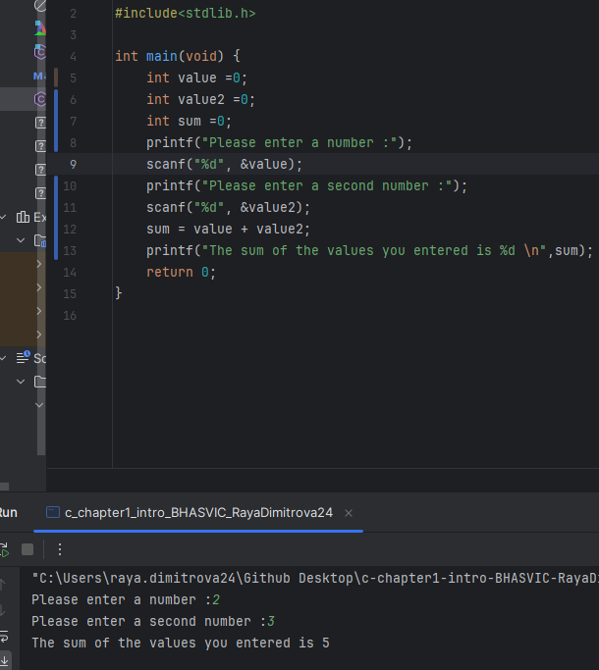
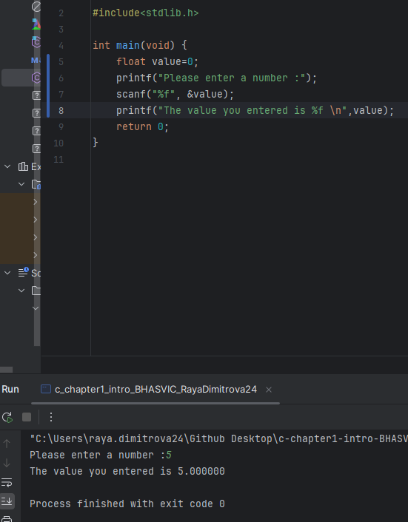
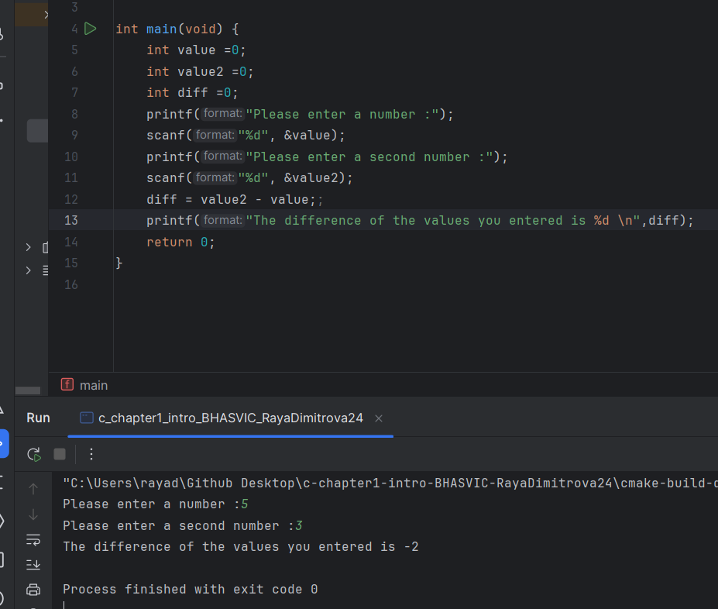
String input
Adds 2 integers
Politer messages with float input
Difference of 2 integers

Slide 7
Make
Make Activities
Write a program that takes the following inputs: – A whole/integer number – A decimal/float number – A letter/char The program should output user friendly messages to show: a) The result of the decimal number subtracted from the whole number b) The result of the product calculated in (a) above multiplied by the ascii value of the letter
Some Data Types | int : %d – a whole number. Uses 2 bytes of storage. float : %f – a real number e.g. has a decimal point. Uses 4/ 8 bytes. char : %c – one individual ASCII character. Uses one byte. string : %s – a list of ASCII characters e.g. a word or series of words

Slide 8
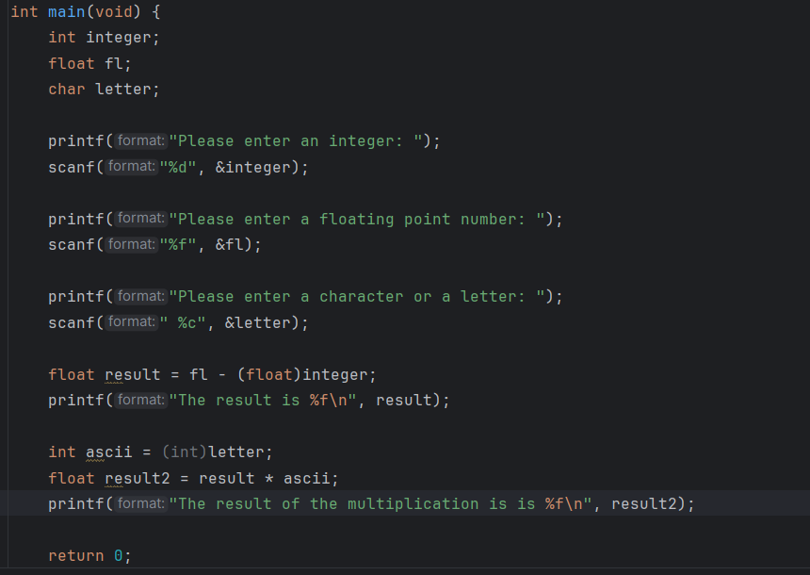
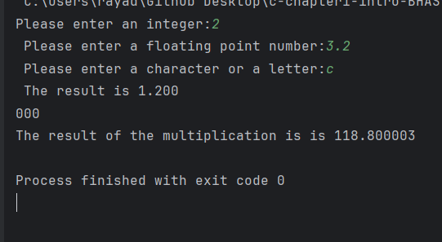

Slide 9
Make
Make Activities
Write a program that asks for a letter to be input in upper case. The program should then output that letter in lower case. To do this, think about each letter’s binary ASCII values and how you could use these to convert them. Useful info: capital ‘A’ = 65 and lower case ‘a’ = 97 (Now make it work the other way!)
Some Data Types | int : %d – a whole number. Uses 2 bytes of storage. float : %f – a real number e.g. has a decimal point. Uses 4/ 8 bytes. char : %c – one individual ASCII character. Uses one byte. string : %s – a list of ASCII characters e.g. a word or series of words

Slide 10
